Slide 1
Lesson-2
THE REGIONAL KINGDOMS-1

Slide 2
Prepare a newspaper report on any temple/Church /Mosque of India.

Slide 3
Kingdoms of Northern India:
The Rajputs: Derived from the sanskrit word ‘rajaputra’.
Kshatriyas
SURYA VANSHI
CHANDRAVANSHI
AGNIKULA
Tomars of Delhi
Chauhans of Rajasthan
Solankis of Gujarat
Paramaras of Malwa
Gahadavalas of Kanauj
Chandellas of bundlekhand
Ghaznavids
Ghorids
6/27/2020
THE REGIONAL KINGDOMS/INTEGRATED SOCIAL SCIENCE/Mrs Sujatha/Social Science/SNS Academy

Slide 4
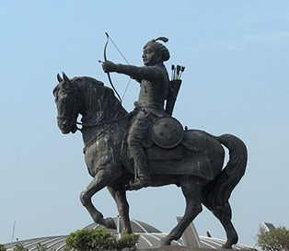
TOMARS OF DELHI
The Tomar ruler Anangpal Tomar,
founded the city of Dhillika(Delhi) in the eighth century.
THE REGIONAL KINGDOMS/INTEGRATED SOCIAL SCIENCE/Mrs Sujatha/Social Science/SNS Academy
6/27/2020

Slide 5
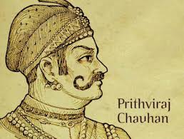
Chauhans of Rajasthan
Prithviraj Chauhan
Chauhans were also known as Chahamanas.
The most powerful Chauhan ruler was
Prithviraj chauhan.
6/27/2020
THE REGIONAL KINGDOMS/INTEGRATED SOCIAL SCIENCE/Mrs Sujatha/Social Science/SNS Academy

Slide 6
QUESTIONS RELATED TO THE ABOVE SLIDES
1) How did the Rajputs explain their origin?
2) Who founded the city of Dhillika?
3) Who was the most important ruler of the Chauhans?

Slide 7
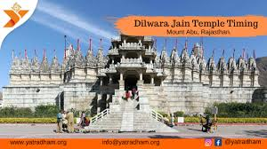
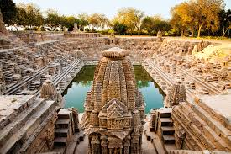
Solankis of Gujarat or Chalukyas of Gujarat
Siddaraja was the most powerful ruler of this dynasty.
The Dilwara temple at Mt Abu and the
Sun temple at Modhera were built by the Solankis.
Dil
6/27/2020
THE REGIONAL KINGDOMS/INTEGRATED SOCIAL SCIENCE/Mrs Sujatha/Social Science/SNS Academy

Slide 8
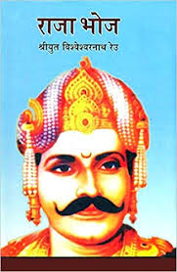
PARAMARAS OF MALWA
Bhoja Paramara was a powerful ruler.
Neelakanteswara temple at Udaipur was built by Paramara.
THE REGIONAL KINGDOMS/INTEGRATED SOCIAL SCIENCE/Mrs Sujatha/Social Science/SNS Academy
6/27/2020

Slide 9
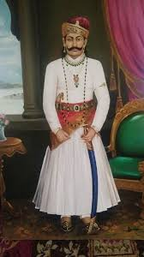
Gahadavalas of kanauj
Gahadavalas ruled over Kanauj.
The Gahadavala King Jaichandra
was defeated by Mohammed Ghori in 1194.
6/27/2020
THE REGIONAL KINGDOMS/INTEGRATED SOCIAL SCIENCE/Mrs Sujatha/Social Science/SNS Academy

Slide 10
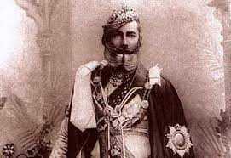
Chandellas of Bundlekhand
They were ruling the land between Yamuna and Narmada rivers.
Khajuraho was the capital.
Kirthivarman was the most important ruler.
6/27/2020
THE REGIONAL KINGDOMS/INTEGRATED SOCIAL SCIENCE/Mrs Sujatha/Social Science/SNS Academy

Slide 11
QUESTIONS RELATED TO ABOVE SLIDES
Name the two temples built by the Solankis of Gujarat.
To which dynasty did King Kirthivarman belong?

Slide 12
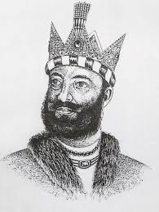
The Ghaznavids
Mohammed Ghazni:
Ruler of Ghazni
In 26 yrs he invaded India 17 times
He looted India.
He attacked rich temples and towns.
Precious stones embedded in the temple walls were taken out.
He carried away all the booty to Ghazni and built a beautiful mosque, library and museum.
He died in 1030.
THE REGIONAL KINGDOMS/INTEGRATED SOCIAL SCIENCE/Mrs Sujatha/Social Science/SNS Academy
6/27/2020

Slide 13
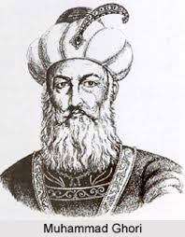
The Ghorids
Mohammed Ghori was an ambitious ruler.
He invaded India not only for wealth but even to build an empire.
In the first battle of Tarain,1191, Mohammed Ghori was defeated by Prithviraj chauhann.
In the second battle of Tarain, in 1192,Mohammed Ghori defeated Prithviraj Chauhan.
THE REGIONAL KINGDOMS/INTEGRATED SOCIAL SCIENCE/Mrs Sujatha/Social Science/SNS Academy
6/27/2020

Slide 14
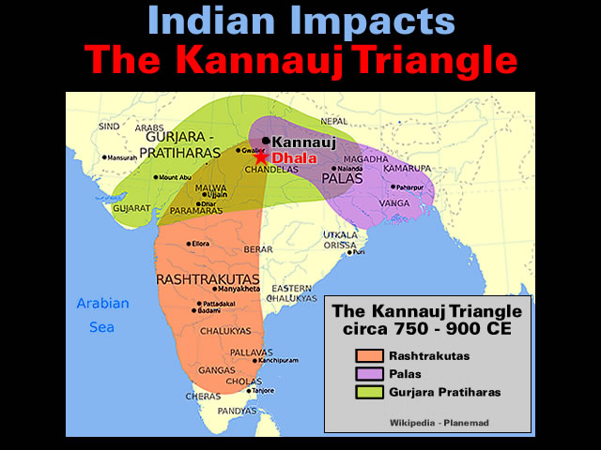
Struggle for Kanauj
Kanauj was rich in minerals, agriculture and trade of the entire
Ganga valley.
In the 8th century, the Palas, Gurjara Pratiharas and Rashtrakutas were engaged in tripartite struggle to control Kanauj.
This struggle lasted for 2 centuries and weakened all the three dynasties .
6/27/2020
THE REGIONAL KINGDOMS/INTEGRATED SOCIAL SCIENCE/Mrs Sujatha/Social Science/SNS Academy

Slide 15
THE PALAS
GOPALA was the first ruler.
Dharmapala and Devapala were the powerful rulers of this dynasty.
The country attained great prosperity during the rule of Palas.
They followed Buddhism.
Built stupas.
Gave money to monasteries.
THE REGIONAL KINGDOMS/INTEGRATED SOCIAL SCIENCE/Mrs Sujatha/Social Science/SNS Academy
6/27/2020

Slide 16
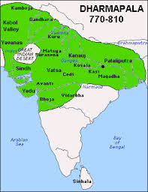
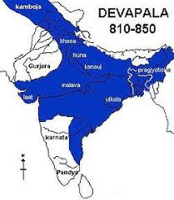
THE PALAS
DHARMAPALA’S EXPANSION
DEVAPALA’S EXPANSION
6/27/2020
THE REGIONAL KINGDOMS/INTEGRATED SOCIAL SCIENCE/Mrs Sujatha/Social Science/SNS Academy

Slide 17
QUESTIONS RELATED TO ABOVE SLIDES.
Give a brief description about Mohammed Ghazni.
2) Explain the first and second battles of Tarain.
3) What do you understand by the statement:
‘The country attained great prosperity during the rule of Palas’.

Slide 18
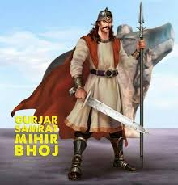
THE GURJARA PRATHIHARAS
King Bhoja was the most famous ruler.
He conquered Kanauj.
His son was Mahendrapala.
This kingdom became weak after his death.
In 1018 Mohammed Ghazni defeated the Pratihara ruler and the dynasty came to an end.
THE REGIONAL KINGDOMS/INTEGRATED SOCIAL SCIENCE/Mrs Sujatha/Social Science/SNS Academy
6/27/2020

Slide 19
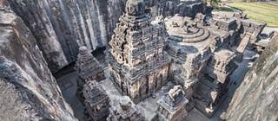
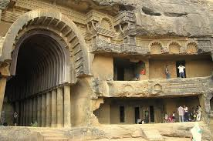
THE RASHTRAKUTAS
Famous rulers:
Dantidurga
Krishna-1
Capital city: Malkhed
Palas
Fought against Pratiharas
Pallavas
Cholas
Pandyas
They became weak.
ImportantT emples :
Kailasa temple at Ellora.
Rock cut caves at Elephanta.
6/27/2020
THE REGIONAL KINGDOMS/INTEGRATED SOCIAL SCIENCE/Mrs Sujatha/Social Science/SNS Academy

Slide 20
OTHER KINGDOMS
YADAVAS OF DEVAGIRI
CHALUKYAS OF KALYANI
Founder of yadavas:
Bhillama.
Ruled between Narmada and Godavari.
They were annexed y the Khalji rulers.
They were also known as
the Later chalukyas or the western Chalukyas.
Greatest ruler :
Vikramanka
Built temples at Aihole, Badami , Pattadakal.
6/27/2020
THE REGIONAL KINGDOMS/INTEGRATED SOCIAL SCIENCE/Mrs Sujatha/Social Science/SNS Academy

Slide 21
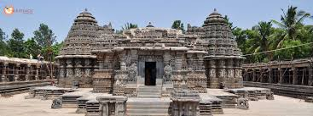
OTHER KINGDOMS
KAKATIYAS OF WARANGAL
HOYSALAS OF DWARASAMUDRA
Ruled between Godavari and Krishna.
They followed:
Shaivism
Jainism
vaishnavism
They were conquered by Delhi Sultanate.
Ruled the region of Karnataka.
Famous king was Vishnuvardhan.
They were defeated by Delhi sultanate.
Hoysaleshwara temple:
6/27/2020
THE REGIONAL KINGDOMS/INTEGRATED SOCIAL SCIENCE/Mrs Sujatha/Social Science/SNS Academy

Slide 22
QUESTIONS RELATED TO ABOVE SLIDES
Who was Mahendrapala?
Name any two temples of the Rashtrakuta period.
Which region did the Hoysalas of Dwarasamudra rule?

Slide 23
KINGDOMS OF SOUTH INDIA
THE PALLAVAS
THE PAllAVAS
Capital city: Kanchi.
Built many beautiful temples.
In the ninth century Cholas defeated the Pallavas and ended their rule.
6/27/2020
THE REGIONAL KINGDOMS/INTEGRATED SOCIAL SCIENCE/Mrs Sujatha/Social Science/SNS Academy

Slide 24
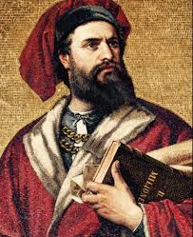
THE PANDYAS
MARCO POLO
Capital city: Madurai.
Marco Polo visited Pandian Kingdom.
The Pandyas declined in the fourteenth century.
6/27/2020
THE REGIONAL KINGDOMS/INTEGRATED SOCIAL SCIENCE/Mrs Sujatha/Social Science/SNS Academy

Slide 25
THE CHOLAS
Powerful empire in South India.
They are known as ‘ Imperial Cholas’.
Ruled for four centuries.
Capital city: Tanjavur
First chola ruler: Vijayalaya
Parantaka conquered Madurai from Pandayas.
Krishna –III (Rashtrakuta king )defeated Parantaka in the battle of Takkolam.
6/27/2020
THE REGIONAL KINGDOMS/INTEGRATED SOCIAL SCIENCE/Mrs Sujatha/Social Science/SNS Academy

Slide 26
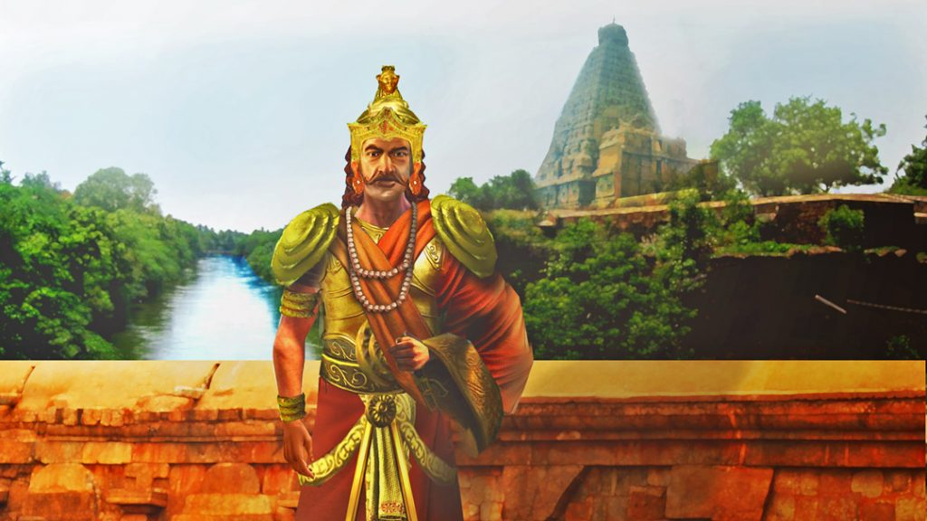
RAJARAJA CHOLA
He was also known as Rajaraja-1
He was a brilliant commander.
Built a strong navy to control trade along coastal areas.
Chola’s fleet captured Srilanka and Maldives..
THE REGIONAL KINGDOMS/INTEGRATED SOCIAL SCIENCE/Mrs Sujatha/Social Science/SNS Academy
6/27/2020

Slide 27
QUESTIONS RELATED TO ABOVE SLIDES
Which was capital city of the Pallavas?
Name the most powerful dynasty of south India.
Can you name the foreigner who visited the kingdom of Pandyas?

Slide 28
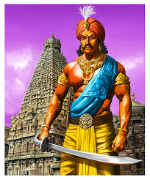
RAJENDRA CHOLA
He was the son of Rajaraja chola.
After defeating the Cheras, the chalukyas, and Palas, he called himself Gangaikonda Chola.
He built a new capital called Gangaikondacholapuram.
He defeated the king of Srivijaya and conquered straits of Molucca.
Trade with South East Asia made them more wealthy.
6/27/2020
THE REGIONAL KINGDOMS/INTEGRATED SOCIAL SCIENCE/Mrs Sujatha/Social Science/SNS Academy

Slide 29
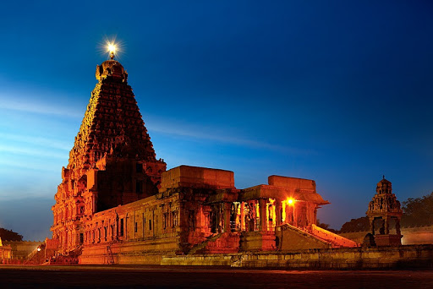
CULTURAL ACHIEVEMENTS
Cholas were great temple builders.
Brihadeshwara temple at Thanjavur is the finest example of Chola architecture.
It is now a
WORLD HERITAGE SITE.
THE REGIONAL KINGDOMS/INTEGRATED SOCIAL SCIENCE/Mrs Sujatha/Social Science/SNS Academy
6/27/2020

Slide 30
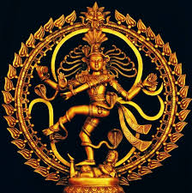
CULTURAL ACHIEVEMENTS
SCULPTURE
LANGUAGE AND LITERATURE
The Cholas excelled in making images of Gods and Goddesses.
They were either in stone or bronze.
The bronze image of Lord Nataraja- Lord of dance is one of the finest specimens of Chola art.
6/27/2020
THE REGIONAL KINGDOMS/INTEGRATED SOCIAL SCIENCE/Mrs Sujatha/Social Science/SNS Academy

Slide 31
LANGUAGE AND LITERATURE
Regional languages like tamil, telugu and kannada witnessed growth.
Many literary works were translated into these languages.
6/27/2020
THE REGIONAL KINGDOMS/INTEGRATED SOCIAL SCIENCE/Mrs Sujatha/Social Science/SNS Academy

Slide 32
QUESTIONS RELATED TO ABOVE SLIDES
Identify the personality:
Clue -1 , He was a chola king.
Clue -2, Son of Raja Raja chola
Clue -3, He built Gangaikondacholapuram.
?

Slide 33
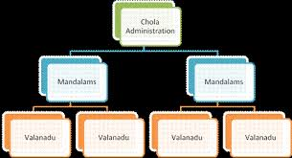
ADMINISTRATION
Each valanadu consisted of number of villages( nadu or kurram)
There were many towns or nagarams such as Tanjore, Kanchi, Puhar.
Special feature: Local self government.
Village(Two assemblies)
Ur Sabha
They also formed sub committees,
Measurement of land under cultivation
Calculation of tax and its collection
Settlement of disputes
Sharing of water
Repairing water tanks and irrigation cannals
were looked after by sub committees.
THE REGIONAL KINGDOMS/INTEGRATED SOCIAL SCIENCE/Mrs Sujatha/Social Science/SNS Academy
6/27/2020

Slide 34
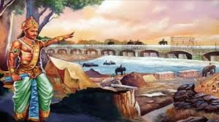
AGRARIAN EXPANSIONS
There were some new developments in agriculture.
Barren and forest land was made fit for cultivation.
Irrigation facilities were extended in new areas.
Better productivity became the primary concern.
THE REGIONAL KINGDOMS/INTEGRATED SOCIAL SCIENCE/Mrs Sujatha/Social Science/SNS Academy
6/27/2020

Slide 35
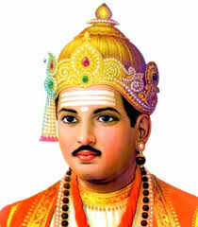
NEW PHILOSOPHIES AND BHAKTI
BASAVA
SHANKARACHARYA
Basava founded the ‘lingayat’ sect in 12th century.
6/27/2020
THE REGIONAL KINGDOMS/INTEGRATED SOCIAL SCIENCE/Mrs Sujatha/Social Science/SNS Academy

Slide 36
REFERENCES
rsgr.in/sh0071
https://www.youtube.com/watch?v=XzjIdWeiDe8
https://www.youtube.com/watch?v=rfHbFV8om4o
https://www.youtube.com/watch?v=fvg44T7U0jg

